Slide 2











Slide 3
Generating Chaos for your microservices
Oscar Vaquero // Miguel Molina

Slide 4
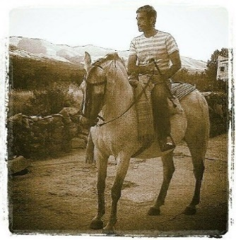
About Us
Oscar Vaquero
Portfolio
.Net Senior dev. At Erni from Sept 2017
Prev. Background Applications and Database team lead at SundioGroup during last 4 years
.Net Architect for the last 6 years
More 10 years C# development
Currently focusing on enterprise architecture definitions.
Technical background: Winforms (10y), WCF (8y), REST (3y), ASP.NET(3y), SQL (8y), XAMARIN (3y), Docker(3y), K8s (1y)
Horse train lover

Slide 5

About Us
Miguel Molina
Portfolio
Senior developer at ERNI
Over 8 years Dotnet development
Currently focused on front-end development (But I still like people calling me full-stack)
Technical background: Silverlight (1y), WPF (1y), ASP.NET(3y), MEAN (0.5y), XAMARIN (0.5y), Angular (1,5y), Blazor(0.5y) ), Docker(1y), K8s (1y)
Tech lover.

Slide 6


Agenda
What is chaos
Intro to k8s
Intro kube-monkey
Simulate 1000 users / sec
Deploy to Azure
Demo
Tips
Links
QA

Slide 7
What is chaos

Slide 8
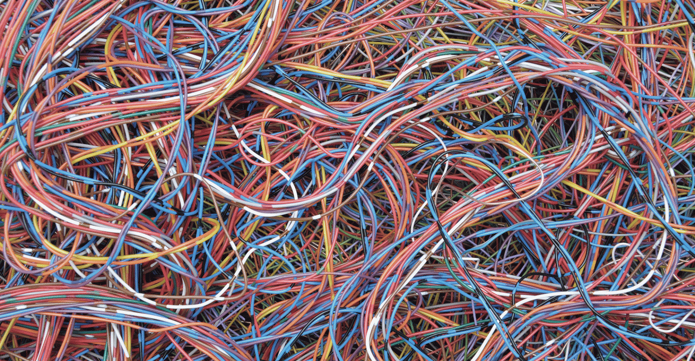
Chaos: When the present determines the future, but the approximate present does not approximately determine the future.
Edward Norton Lorenz (May 23, 1917 – April 16, 2008)
Notes:
Edward Norton Lorenz (May 23, 1917 – April 16, 2008) was an American mathematician and meteorologist who established the theoretical basis of weather and climate predictability, as well as the basis for computer-aided atmospheric physics and meteorology.^{[1][2]} He is best known as the founder of modern chaos theory, a branch of mathematics focusing on the behavior of dynamical systems that are highly sensitive to initial conditions.^{[3]}

Slide 9
How many of you have never encountered a crash or a failure of your systems in a production environment?
Notes:
Certainly, each one of you, sooner or later, has experienced it.
If we are not able to avoid a failure, the solution seems to be maintaining our system in a state of permanent failure.
This concept underpins the tool invented by Netflix to test the resilience of its IT infrastructure — Chaos Monkey

Slide 10
What is chaos
“Chaos engineering” is the methodical design and implementation of experiments to test assumptions about—and discover previously unknown behaviors of—distributed service architectures. Given that communication-related degradations and failures are frequent and natural characteristics of distributed architectures, particularly at scale, chaos engineering is an essential practice to improve the resilience of a distributed microservices application.

Slide 11
The practice of chaos engineering was pioneered by Netflix as a method to increase the stability and resilience of their growing, large-scale microservice application.
For instance, to determine if their services would degrade gracefully in the face of network outages, Netflix would run a “Chaos Monkey” program that would simulate the effect of randomly “pulling cables” in the network. This allowed Netflix’ engineers to learn whether services timed out as intended, didn’t end up in a spinlock that chewed up system resources or employed a sound retry strategy.

Slide 12
Netflix evolution
Cloud
Own data center
Monolites
3 days broken DB
Quality focused
Customers x8
Decentralized DB’s
Starts working with microservices
Works within 3 regions
Cassandra
Escalable
Big data
2008
2016
2017

Slide 13
Goal
The goal with chaos engineering is to verify that the system will behave as expected during adverse conditions, and in case it won’t, to learn what steps can be taken to make it more resilient.
Notes:
The objective of Chaos is to sabotage our productive environment randomly, so that the engineering team can never predict when it will be sabotage.

Slide 14
Intro to k8s

Slide 15
What does kubernetes do?
Kubernetes (K8s) is an open-source system for automating deployment, scaling, and management of containerized applications.

Slide 16
What does kubernetes do?
Runtime for docker containers
Scale and balance docker containers
Self healing (healthchecks)
Update containers
Storage mounting
Service exposure
Secret management
Batch execution
Automated rollouts and rollbacks

Slide 17
What doesn’t kubernetes do?
Don’t deploy source code
Compile or build your code
Does not provide application level services as databases, messagebuses

Slide 18
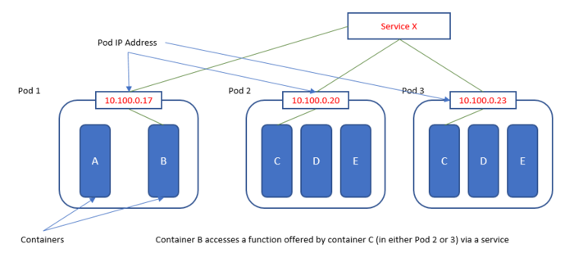
Kubernetes Objects
Kubernetes defines a set of building blocks ("primitives"), which collectively provide mechanisms that deploy, maintain, and scale applications based on CPU, memory or custom metrics
Pods
Replica sets
Services
Volumes
NameSpaces
Stateful Sets

Slide 19

Pod
A Kubernetes pod is a group of containers that are deployed together on the same host. If you frequently deploy single containers, you can generally replace the word "pod" with "container" and accurately understand the concept.
Each pod in Kubernetes is assigned a unique Pod IP address within the cluster, which allows applications to use ports without the risk of conflict.
An application developer should never use the Pod IP Address though, to reference / invoke a capability in another pod, as Pod IP addresses are ephemeral - the specific pod that they are referencing may be assigned to another Pod IP address on restart. Instead, they should use a reference to a Service, which holds a reference to the target pod at the specific Pod IP Address

Slide 20

Replicaset
A ReplicaSet’s purpose is to maintain a stable set of replica Pods running at any given time. As such, it is often used to guarantee the availability of a specified number of identical Pods.

Slide 21

Service
A Kubernetes service is a set of pods that work together, such as one tier of a multi-tier application. The set of pods that constitute a service are defined by a label selector. Kubernetes provides two modes of service discovery, using environmental variables or using Kubernetes DNS. Service discovery assigns a stable IP address and DNS name to the service, and load balances traffic
By default a service is exposed inside a cluster, but a service can also be exposed outside a cluster

Slide 22

Volumes
A Kubernetes Volume provides persistent storage that exists for the lifetime of the pod itself.
This storage can also be used as shared disk space for containers within the pod.
Volumes are mounted at specific mount points within the container, which are defined by the pod configuration, and cannot mount onto other volumes or link to other volumes. The same volume can be mounted at different points in the filesystem tree by different containers.

Slide 23
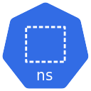
NameSpaces
Kubernetes provides a partitioning of the resources it manages into non-overlapping sets called namespaces.
They are intended for use in environments with many users spread across multiple teams, or projects, or even separating environments like development, test, and production.

Slide 24
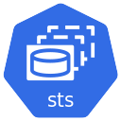
StatefulSets
It is very easy to address the scaling of stateless applications: one simply adds more running pods—which is something that Kubernetes does very well.
Stateful workloads are much harder, because the state needs to be preserved if a pod is restarted, and if the application is scaled up or down, then the state may need to be redistributed.
Databases are an example of stateful workloads. When run in high-availability mode, many databases come with the notion of a primary instance and a secondary instance(s).

Slide 25
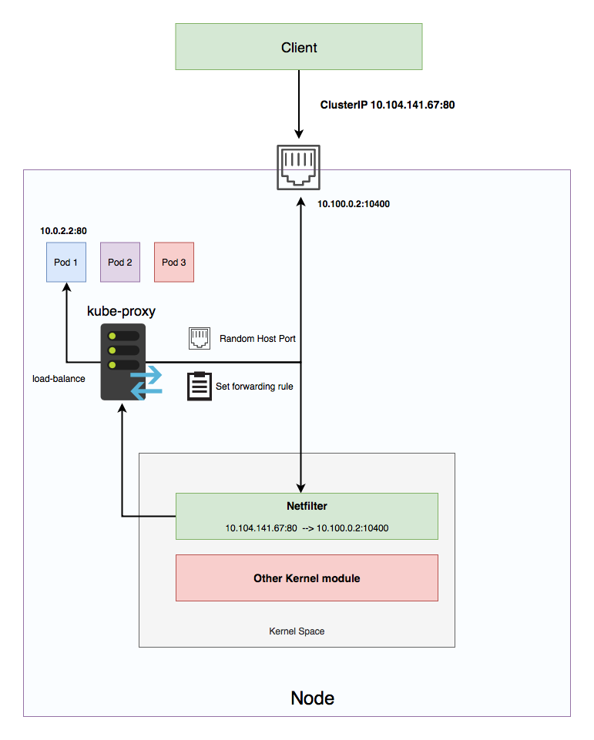
Kube-proxy
kube-proxy is responsible for watching client requests to some IP:port and forwarding/proxying them to the corresponding service/application on the private network.

Slide 26

K8’s Replica set/pod example
Replicas: 5
Template pod
container
container
container
container
container
container
container
container
container
container
container
container
container
container
container
container
container
container

Slide 27
Intro kube-monkey

Slide 28
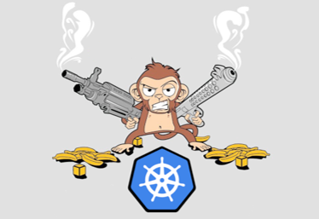

Kube-monkey
kube-monkey is an implementation of Netflix's Chaos Monkey for Kubernetes clusters. It randomly deletes Kubernetes (k8s) pods in the cluster encouraging and validating the development of failure-resilient services.

Slide 29

How it works
Kube-Monkey gets a list of marked nodes with the required labels and destroy them
Replicas: 5
Template pod
container
container
container
container
container
container
container
container
container
container
container
container
container
container
container
container
container
container

Slide 30
Execution Time
Scheduling time
Scheduling happens once a day on Weekdays - this is when a schedule for terminations for the current day is generated. During scheduling, kube-monkey will:
Generate a list of eligible k8s apps (k8s apps that have opted-in and are not blacklisted, if specified, and are whitelisted, if specified)
For each eligible k8s app, flip a biased coin (bias determined by kube-monkey/mtbf) to determine if a pod for that k8s app should be killed today
For each victim, calculate a random time when a pod will be killed
Termination time
This is the randomly generated time during the day when a victim k8s app will have a pod killed. At termination time, kube-monkey will:
Check if the k8s app is still eligible (has not opted-out or been blacklisted or removed from the whitelist since scheduling)
Check if the k8s app has updated kill-mode and kill-value
Depending on kill-mode and kill-value, execute pods

Slide 31
Kill Modes
"kill-all" if you want kube-monkey to kill ALL of your pods regardless of status (not ready or not running pods included). Does not require kill-value. Use this label carefully.
“fixed” if you want to kill a specific number of running pods with kill-value. If you overspecify, it will kill all running pods and issue a warning.
“random-max-percent” to specify a maximum % with kill-value that can be killed. At the scheduled time, a uniform random specified % of the running pods will be terminated.
“fixed-percent” to specify a fixed % with kill-value that can be killed. At the scheduled time, a specified fixed % of the running pods will be terminated.

Slide 32
Kill Values
Fixed, provide an integer of pods to kill
Random-max-percent, provide a number from 0-100 to specify the max % of pods kube-monkey can kill
Fixed-percent, provide a number from 0-100 to specify the % of pods to kill

Slide 33
K8’s Replica set example
Replicas: 10
Template pod
container
container
container
container
container
container
container
container
container
container
container
container
container
container
container
container
container
container

Slide 34
K8’s pod kill
Replicas: 10
Template pod
container
container
container
container
container
container
container
container
container
container
container
container
container
container
container
container
container
container

Slide 35

K8’s Replica set restarting
Replicas: 10
Template pod
container
container
container
container
container
container
container
container
container
container
container
container
container
container
container
container
container
container

Slide 36
K8’s Replica set restarting
Replicas: 10
Template pod
container
container
container
container
container
container
container
container
container
container
container
container
container
container
container
container
container
container

Slide 37
K8’s Replica set restarting
Replicas: 10
Template pod
container
container
container
container
container
container
container
container
container
container
container
container
container
container
container
container
container
container

Slide 38
K8’s Replica set end status
Replicas: 10
Template pod
container
container
container
container
container
container
container
container
container
container
container
container
container
container
container
container
container
container

Slide 39
K8’s kube proxy
container
container
container
container
container
container
container
container
container
container
container
container
container
container
container
Load balancer (kube-proxy)

Slide 40
how to simulate 1000 users / sec

Slide 41
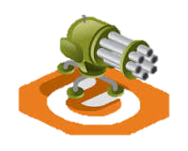
Gatling
Gatling is an open-source load and performance testing framework based on Scala, Akka and Netty. ... The software is designed to be used as a load testing tool for analyzing and measuring the performance of a variety of services, with a focus on web applications

Slide 42
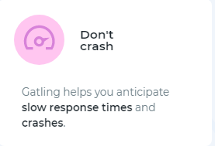
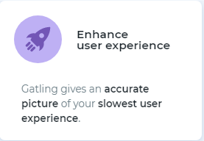
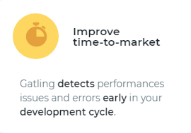
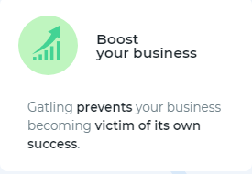
Features

Slide 43
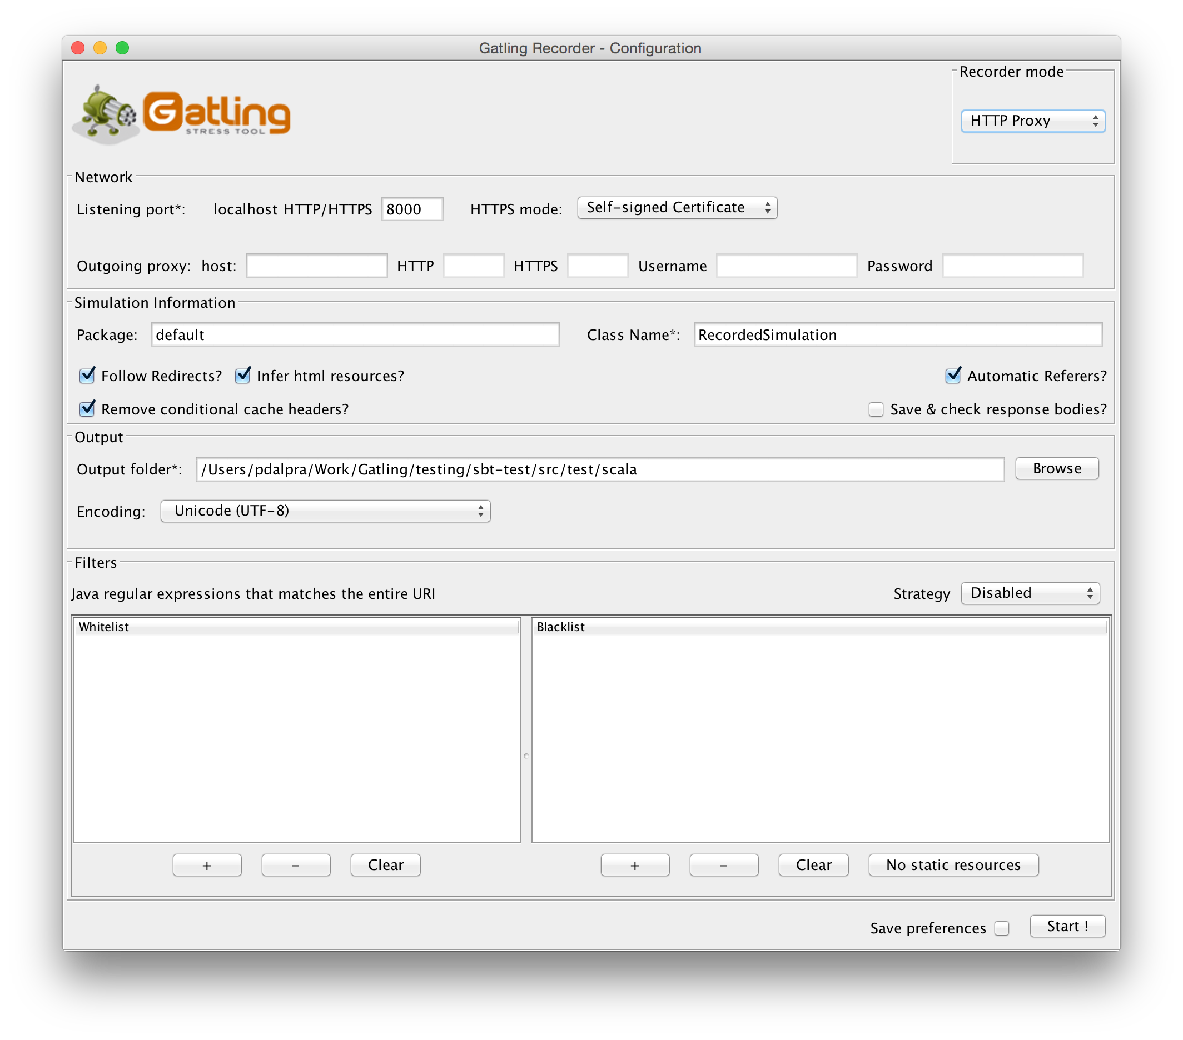
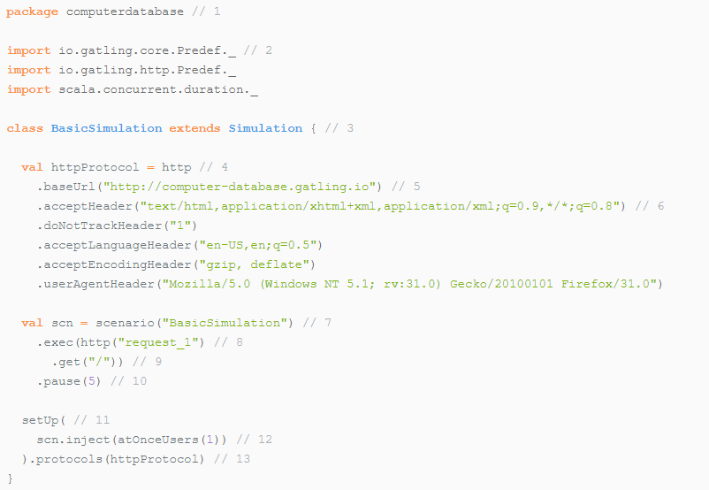
How to create a gatling simulation
By Scala code
By Gatling recorder

Slide 44
Sample Scala Gatling Scenarios

Slide 45
Gatling
Building blocks profile injection
nothingFor(duration): Pause for a given duration.
atOnceUsers(nbUsers): Injects a given number of users at once.
rampUsers(nbUsers) during(duration): Injects a given number of users with a linear ramp over a given duration.
constantUsersPerSec(rate) during(duration): Injects users at a constant rate, defined in users per second, during a given duration. Users will be injected at regular intervals.

Slide 46
Gatling
Building blocks profile injection
constantUsersPerSec(rate) during(duration) randomized: Injects users at a constant rate, defined in users per second, during a given duration. Users will be injected at randomized intervals.
rampUsersPerSec(rate1) to (rate2) during(duration): Injects users from starting rate to target rate, defined in users per second, during a given duration. Users will be injected at regular intervals.
rampUsersPerSec(rate1) to(rate2) during(duration) randomized: Injects users from starting rate to target rate, defined in users per second, during a given duration. Users will be injected at randomized intervals.
heavisideUsers(nbUsers) during(duration): Injects a given number of users following a smooth approximation of the heaviside step function stretched to a given duration.

Slide 47
Gatling
Isolate processes
object Search {
val search = exec(http("Home") // let's give proper names, as they are displayed in the reports
.get("/"))
.pause(7)
.exec(http("Search")
.get("/computers?f=macbook"))
.pause(2)
.exec(http("Select")
.get("/computers/6"))
.pause(3)
}
object Browse {
val browse = ???
}
object Edit {
val edit = ???
}
).protocols(httpProtocol)
val scn = scenario("Scenario Name").exec(Search.search, Browse.browse, Edit.edit)

Slide 48
Gatling
Configure virtual users
val users = scenario("Users").exec(Search.search, Browse.browse)
val admins = scenario("Admins").exec(Search.search, Browse.browse, Edit.edit)
setUp(
users.inject(rampUsers(10) during (10 seconds)),
admins.inject(rampUsers(2) during (10 seconds))
).protocols(httpProtocol)

Slide 49
Gatling
Use dynamic data with Feeders
object Search {
val feeder = csv("search.csv").random // 1, 2
val search = exec(http("Home")
.get("/"))
.pause(1)
.feed(feeder) // 3
.exec(http("Search")
.get("/computers?f=${searchCriterion}") // 4
.pause(1)
.exec(http("Select")
.get("${computerURL}")) // 6
.pause(1)
}

Slide 50
Gatling
Check and failure management
val edit = exec(http("Form")
.get("/computers/new"))
.pause(1)
.exec(http("Post")
.post("/computers")
.check(status.is(session => 200 + ThreadLocalRandom.current.nextInt(2))))
val tryMaxEdit =
pause(2) {
.exec(http("Post")
.exitHereIfFailed

Slide 51
Gatling
Looping
object Browse {
def gotoPage(page: Int) = exec(http("Page " + page)
.get("/computers?p=" + page))
.pause(1)
val browse = exec(gotoPage(0), gotoPage(1), gotoPage(2), gotoPage(3), gotoPage(4))
}

Slide 52
Gatling
Scenario sample
val initScenario =
scenario("init scenario") .exec(ApiGet.Weather)
.exitHereIfFailed
setUp(
initScenario.inject(
nothingFor(4 seconds),
atOnceUsers(10),
rampUsers(10) during (5 seconds),
constantUsersPerSec(20) during (15 seconds),
constantUsersPerSec(20) during (15 seconds) randomized,
rampUsersPerSec(10) to 20 during (10 minutes),
rampUsersPerSec(10) to 20 during (10 minutes) randomized,
heavisideUsers(1000) during (20 seconds)
).protocols(httpProtocol)
)

Slide 53
Deploy to Azure

Slide 54
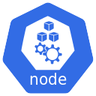




Microservices chaos full – Load tests
Weather Service
Api
UI
Mongo
Redis
Gatling tests
Kube-monkey

Slide 55
Demo

Slide 56
Tips

Slide 57

Polly
Polly is a .NET resilience and transient-fault-handling library that allows developers to express policies such as Retry, Circuit Breaker, Timeout, Bulkhead Isolation, and Fallback in a fluent and thread-safe manner.

Slide 58
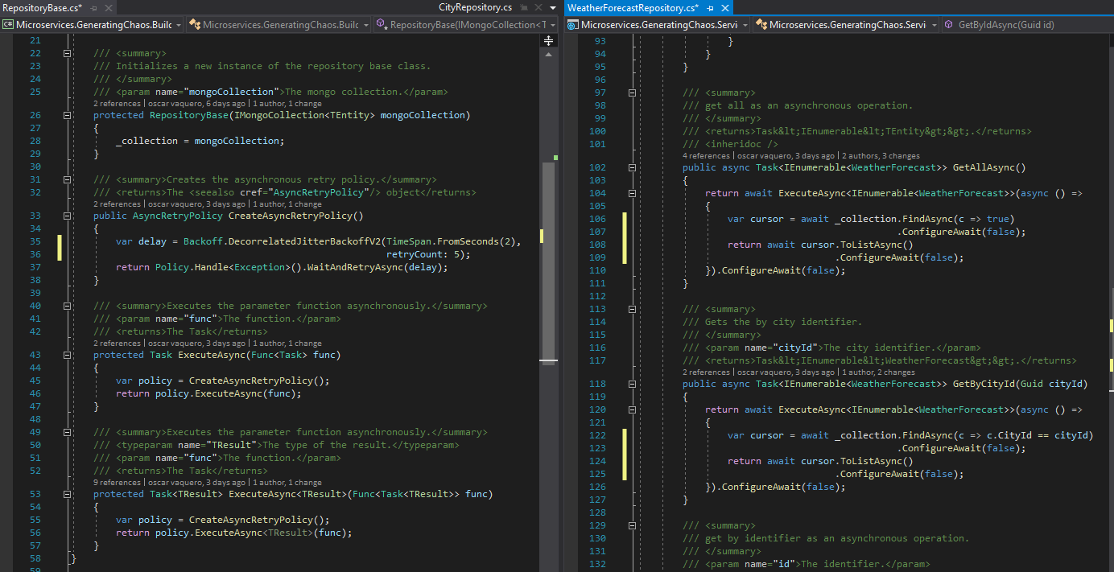

Slide 59
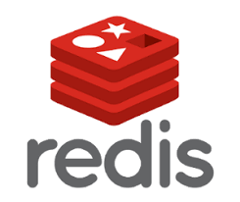
Cache - Redis
Redis is an open source (BSD licensed), in-memory data structure store, used as a database, cache and message broker. It supports data structures such as strings, hashes, lists, sets, sorted sets with range queries, bitmaps, hyperloglogs, geospatial indexes with radius queries and streams. Redis has built-in replication, Lua scripting, LRU eviction, transactions and different levels of on-disk persistence, and provides high availability via Redis Sentinel and automatic partitioning with Redis Cluster

Slide 60
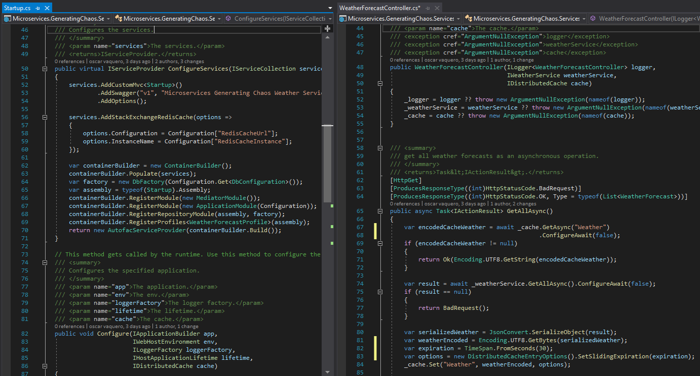

Slide 61
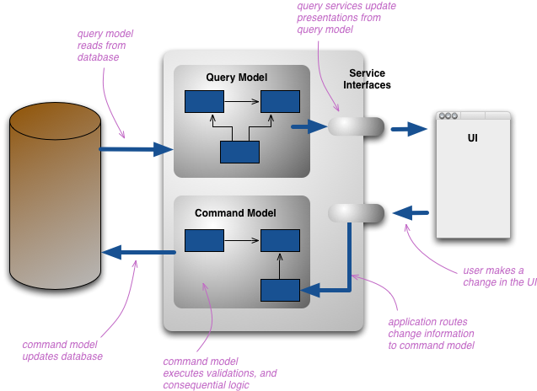
CQRS
CQRS stands for Command Query Responsibility Segregation. It's a pattern that I first heard described by Greg Young.
At its heart is the notion that you can use a different model to update information than the model you use to read information.
For some situations, this separation can be valuable, but beware that for most systems CQRS adds risky complexity.
https://martinfowler.com/bliki/CQRS.html

Slide 62
Links

Slide 63
Links
Demo repo: https://github.com/Rabosa616/NetConf2019_MicroservicesGeneratingChaos
Chaos Principles: http://principlesofchaos.org/?lang=ENcontent
Netflix Chaos monkey: https://netflix.github.io/chaosmonkey/
Kube-monkey github: https://github.com/asobti/kube-monkey
Gatling home page: https://gatling.io/
Polly: https://github.com/App-vNext/Polly
CQRS: https://martinfowler.com/bliki/CQRS.html
Redis: https://redis.io/documentation

Slide 64
QA

